Slide 1
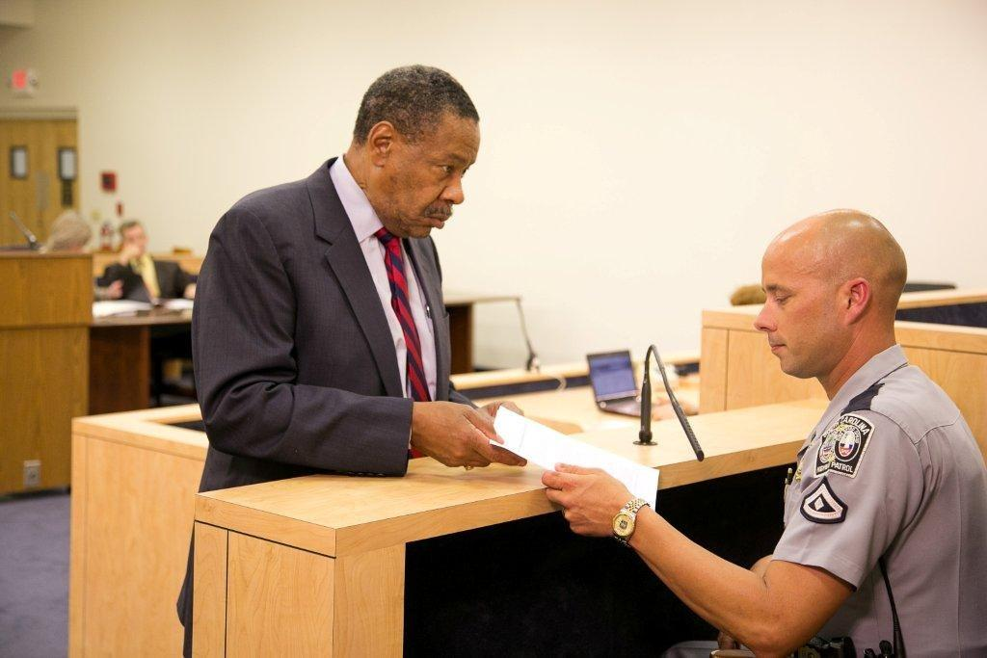



Session 4
Overview of Detection,
Note Taking,
and Testimony

Slide 2

Learning Objectives
Describe the three phases of detection and the tasks and key decision of each phase
Discuss uses of a standard note taking guide
Discuss guidelines for effective testimony

Slide 3
DWI Detection
The entire process of identifying and gathering evidence to determine if a subject should be arrested for a DWI violation.

Slide 4
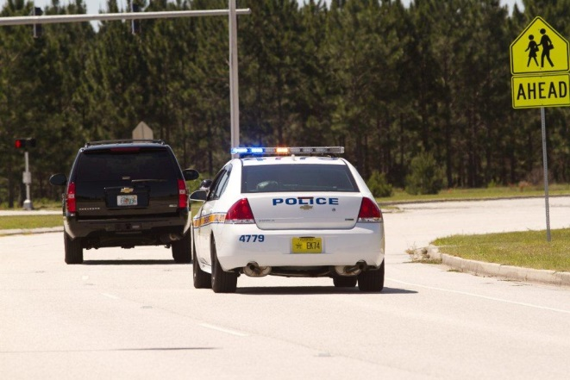
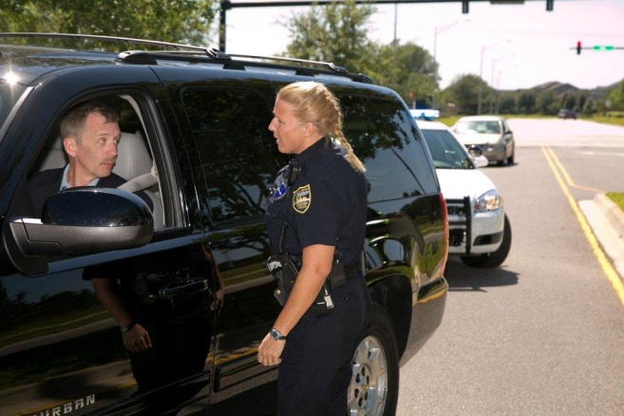
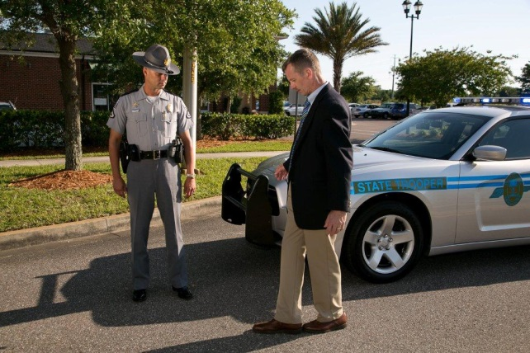
DWI Detection Phases
Phase One
Phase Two
Phase Three
Pre-Arrest Screening
Vehicle in Motion
Personal Contact

Slide 5


Decisions/Possible Outcomes
Decisions
Phase One - Stop?
Phase Two - Exit?
Phase Three - Arrest?
Possible Outcomes
Yes - Do it now
Wait - Look for more evidence
No - Don’t do it

Slide 6
Decisions
Phase One: Vehicle in Motion
Should I stop the vehicle?
Phase Two: Personal Contact
Should the driver exit?
Phase Three: Pre-arrest Screening
Is there probable cause to arrest the suspect for DWI?

Slide 7
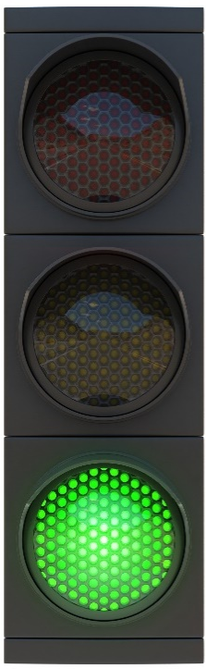
Possible Outcomes – Yes
Phase One: Yes, there are reasonable grounds to stop the vehicle
Phase Two: Yes, there is enough reason to suspect impairment to justify getting the driver out of the vehicle for further investigation
Phase Three: Yes, there is probable cause to arrest driver for DWI right now

Slide 8
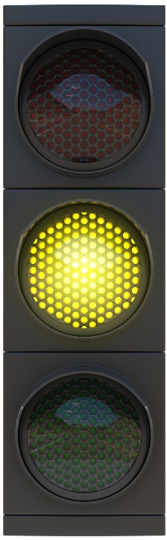
Possible Outcomes - Wait
Phase One: Don't stop the vehicle yet
Phase Two: Don't get the driver out of the car yet
Phase Three: Don't arrest the driver yet

Slide 9

Possible Outcomes - No
Phase One: No, there are no grounds for stopping that vehicle
Phase Two: No, there isn't enough evidence of DWI to justify administering field sobriety tests
Phase Three: No, there is not sufficient probable cause to believe this driver has committed DWI

Slide 10





Arrest Decision
1
2
3
4
5
6
Initial observation of vehicle operation
Face to face observation and interview
Observation of the stop
Observation of the exit
Preliminary breath test
SFSTs

Slide 11
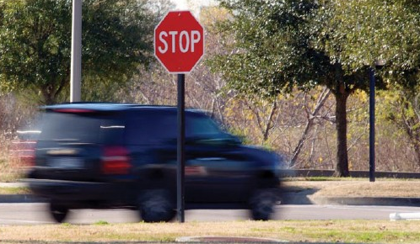
DWI Detection – Phase One
What is the vehicle doing?
Do I have grounds to stop the vehicle?
How does the driver respond to my signal to stop?
How does the driver handle the vehicle during the stopping sequence?

Slide 12

DWI Detection – Phase Two
Vehicle approach: What do I see?
Talking with driver: What do I hear, see, smell?
How does the driver respond to questions?
Should I instruct the driver to exit vehicle?
How does the driver exit?
When the driver walks toward the side of the road, what do I see?

Slide 13
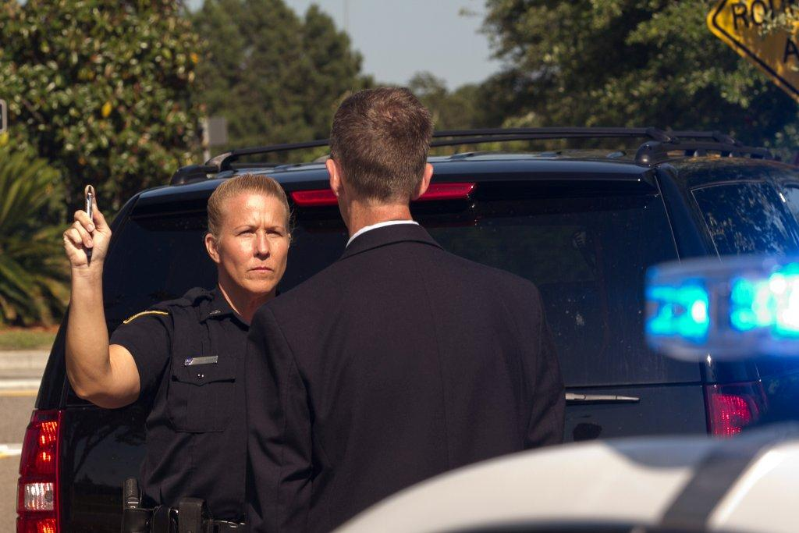
DWI Detection – Phase Three
Should I administer SFSTs to the driver?
How does the driver perform those tests?
What indicators of impairment did I observe while the driver performed these tests?
Do I have probable cause to arrest for DWI?
Should I administer a preliminary breath test?
What are the results of the preliminary breath test?

Slide 14
Successful DWI Detection
Know what to observe
Ask the right kinds of questions
Use the right kinds of tests
Interpret, document, and articulate all observations thoroughly
Be motivated and apply your knowledge and skills

Slide 15
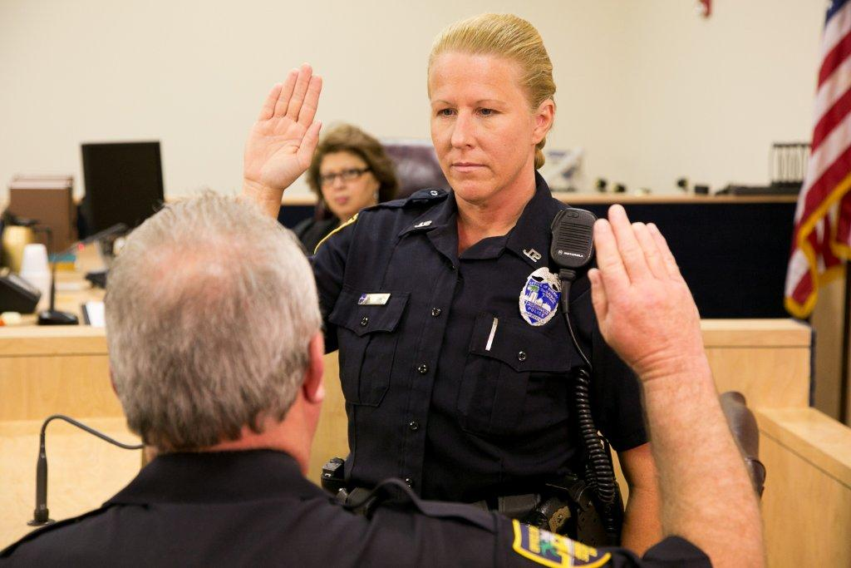
Note Taking and Testimony
Graphically describe your observations
Convey evidence clearly and convincingly
Importance of field notes

Slide 16

Use Clear Convincing Language

Slide 17
Vague Clear
Made an illegal left turn on Jefferson
Drove erratically
Driver appeared drunk, shaking
From Main, turned left (north bound) on Jefferson, which is one way south bound
Weaving from side to side. Crossed center line twice and drove on shoulder three times
Driver’s eyes bloodshot; gaze fixed; Strong odor of alcoholic beverage on driver’s breath

Slide 18
Vague Clear
Vehicle stopped in unusual fashion
Vehicle crossed the center line
Vehicle struck, climbed curb; stopped on sidewalk
Vehicle drifted completely into the opposing traffic lane

Slide 19
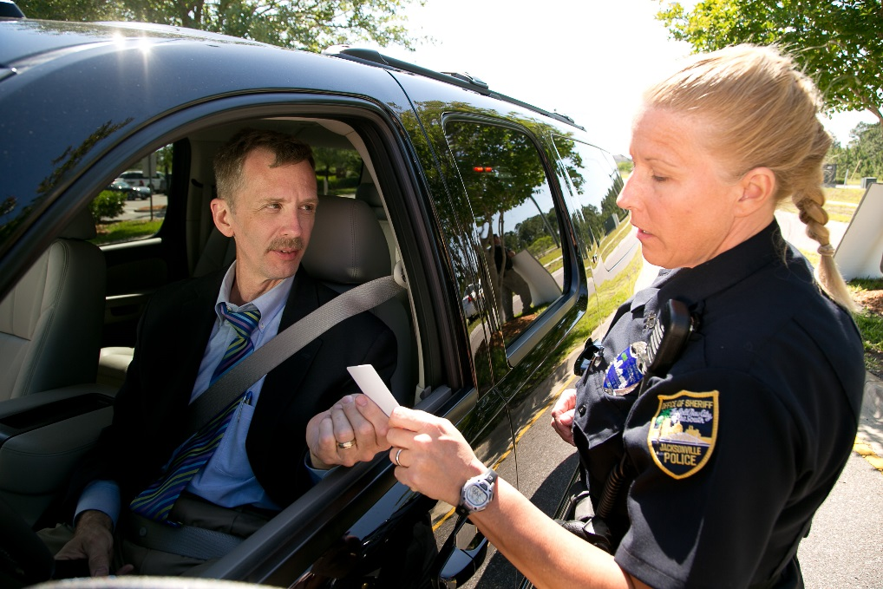
Officer Must Be Able To
Recognize and interpret DWI evidence
Describe the evidence clearly and convincingly

Slide 20
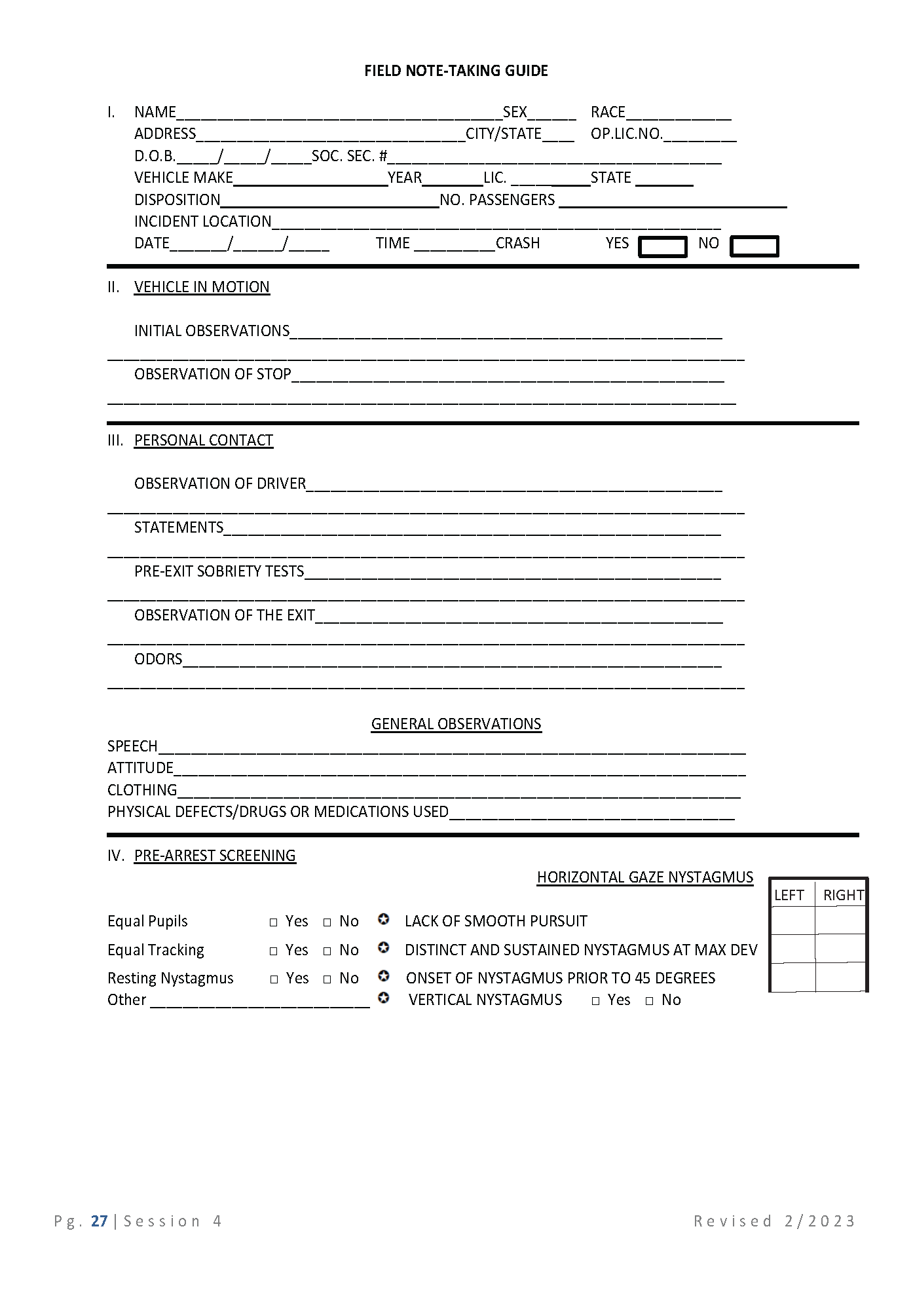
Observations - Short-Lived Evidence

Slide 21
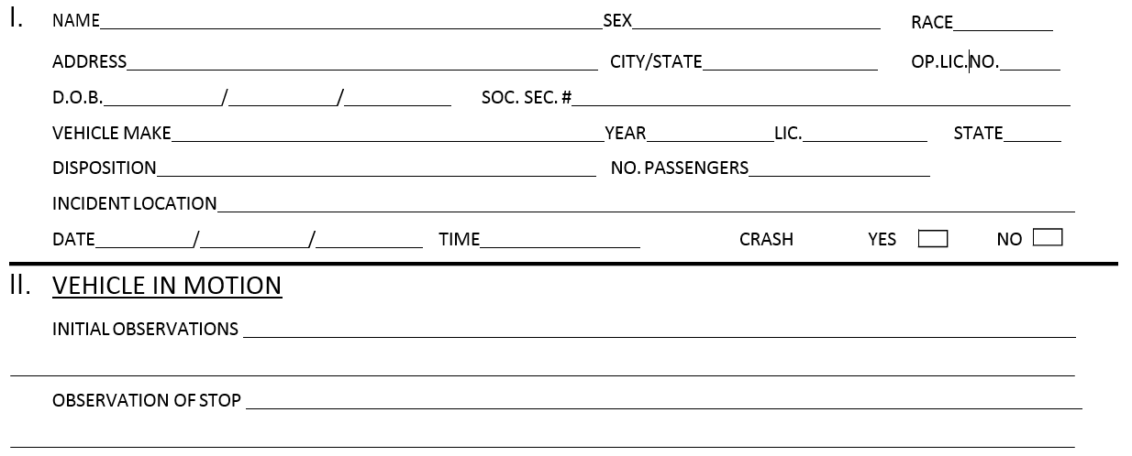
Field Note-Taking Guide

Slide 22
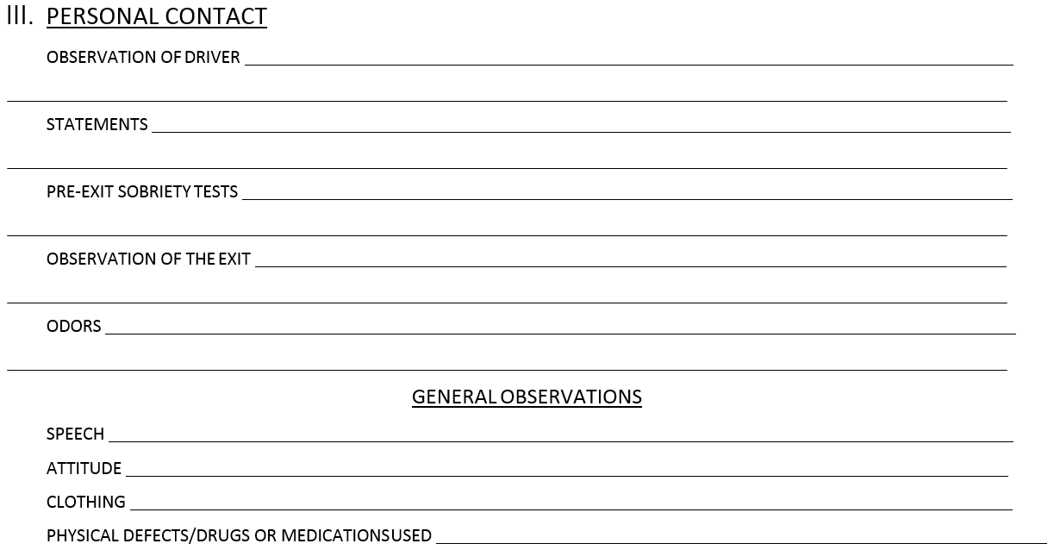
Field Note-Taking Guide

Slide 23
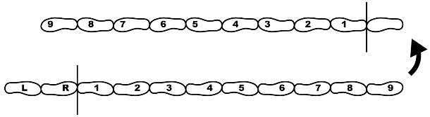
Field Note-Taking Guide
WALK AND TURN
INSTRUCTION STAGE
CANNOT KEEP BALANCE
STARTS TOO SOON
WALKING STAGE | FIRST NINE STEPS | SECOND NINE STEPS
STOPS WALKING
MISSES HEEL-TO-TOE
STEPS OFF LINE
USES ARM(S) TO BALANCE
ACTUAL STEPS TAKEN
IMPROPER TURN (Describe)
CANNOT COMPLETE TEST (Explain)
OTHER:

Slide 24
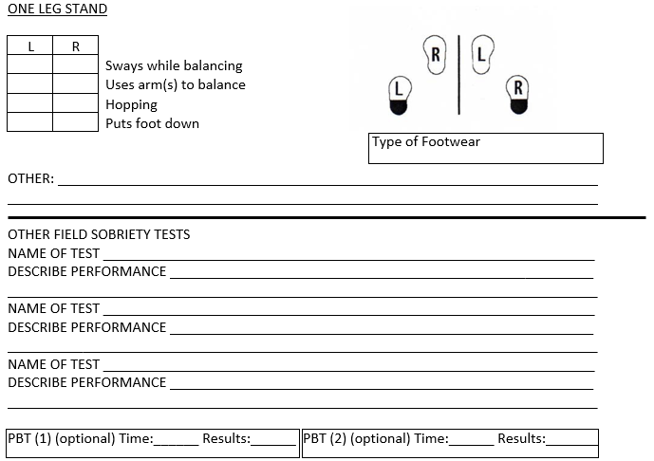
Field Note-Taking Guide

Slide 25
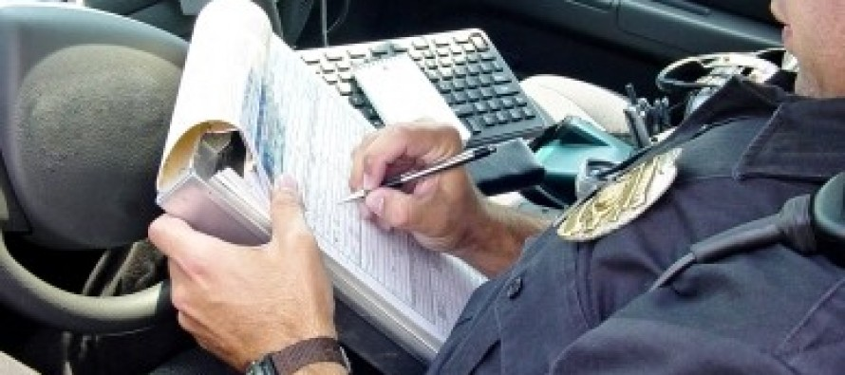
Preparing Testimony
At time of incident:
Recognize evidence
Compile notes
Prepare report

Slide 26
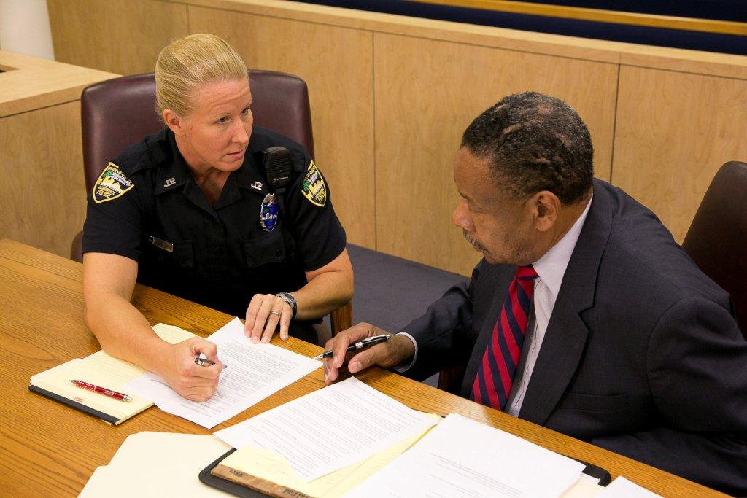
Preparing Testimony
Prior to trial:
Review paperwork
Review other evidence
Mentally organize elements, evidence, and testimony
Identify potential issues
Discuss with prosecutor

Slide 27
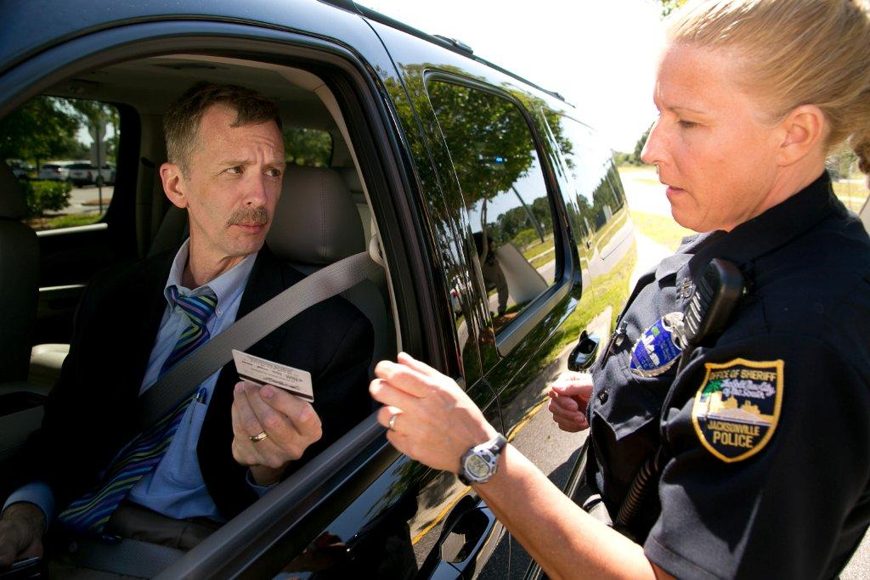
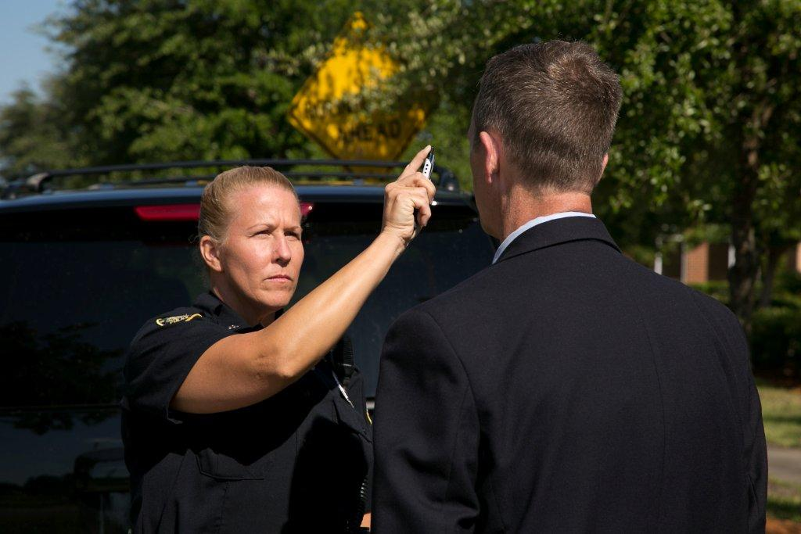
Chronology of Testimony

Slide 28
Chronology of Testimony
Arrest and post arrest observations:
Arrest procedures and admonitions
Defendant’s actions and statements
Post arrest observations
Request for chemical test(s)
Administration and results of chemical test(s)
Interview

Slide 29
Questions?

Slide 30
Test Your Knowledge
DWI detection is defined as __________
The three phases in a typical DWI contact are:
Phase One ___________
Phase Two ___________
Phase Three __________
In Phase One, the officer usually has an opportunity to_____________________

Slide 31
Test Your Knowledge
Phase Three may not occur if ________
In Phase Two, the officer must decide _______
Each major decision can have any one of _____ different outcomes.
These are ________________________.

Slide 32
Test Your Knowledge
At each phase of detection, the officer must determine ____________________
Evidence of DWI is largely ________ in nature
Law enforcement officers need a system and tools for recording field notes at scenes of DWI investigations because DWI evidence is _____.

Slide 33
Test Your Knowledge
Testimony preparations begins_____
List two things the officer should do to prepare testimony just before the trial.
In court, the officer’s testimony should be organized _____________.

